Slide 1

Early Forecast of low birth weight cases using Ensemble Learning techniques
by
K. Samyuktha
Roll No. 204G1A0592
N. Ranga Dhamini
Roll No. 204G1A0579
S. Vandana Bai
Roll No. 204G1A05B9
B. Vishnu
Roll No. 204G1A05C3
Under the guidance of
Mrs. M. Soumya M.Tech (Ph.D)
Assistant Professor
Department of Computer Science and Engineering
Srinivasa Ramanujan Institute of Technology
(Autonomous)
2023 - 2024

Slide 2

Contents
Abstract
Problem statement
Objectives of Project
Literature survey for first objective
Literature survey for second objective
Proposed Work -(Methods to be followed for proposed system)
References
GitHub Link
Queries

Slide 3
Abstract
Low Birth weight acts as an indicator of sickness in newborn babies. LBW is closely associated with infant mortality as well as various health outcomes later in life. Machine learning techniques are used to gain useful information from health indicators of pregnant women for early detection of potential low birth weight cases. Low birth weight in infants leads to a range of health and developmental problems like respiratory distress syndrome and difficulties in temperature regulation
Ensemble Learning techniques like Stacking are used for better model. Maternal factors such as age, ethnicity, education, and medical history are included, along with prenatal factors such as the number of prenatal care visits, gestational age, maternal weight gain, and smoking status are used as attributes in dataset.

Slide 4
Problem Statement
Low birth weight of a unborn child is a critical issue that poses significant risks to both neonatal health and long-term development. Due to low weight at birth, babies are at a higher risk of mortality during the neonatal period (first 28 days of life) due to their vulnerability to infections and other complications.
To avoid such risks, identification of low birth weight cases is essential for implementing timely interventions and personalized care strategies to improve maternal and neonatal outcomes.

Slide 5
Objectives of Project
To reduce the neonatal mortality rate by using machine learning model capable of predicting low birth weight (LBW) cases during early stages of pregnancy, utilizing a dataset of maternal and prenatal factors.
To develop a high accuracy model form a range of machine learning algorithms, including XGboost, decision trees, random forests, and support vector machines for sacking technique.

Slide 6
Literature survey for first objective
Low birth weight (LBW) is a major cause of neonatal mortality. It is defined as a birth weight of less than 2,500 grams. There are many factors that can contribute to LBW, including maternal health, prenatal care, and environmental factors. Machine learning models have been used to predict LBW cases with varying degrees of success[1]. For dataset age, parity, hemoglobin, initial and last weight, disease control, body mass index etc are used. There were 2702 observations in the data set [1]. Results of various algorithm performance is given for further research. C45 has highest accuracy among used algorithms.

Slide 7
Literature survey for second objective
Different research works are done using multiple models to find accurate model for better accuracy. Logistic regression, multiple linear regression, artificial neural network, decision tree, naïve bayes etc are applied on large dataset and gave conclusion artificial neural network is better[2]. For accurate prediction women’s pregnancy history and identified maternal underweight, malaria and anemia as risk factors for preterm birth but HIV status does not contribute to the risk of preterm births [2]. Precision and recall are also calculated along with accuracy. Future scope is to improve the accuracy of prediction by using soft computing techniques making the prediction of low birth weight easily[2].

Slide 8
Proposed System
To overcome the difficulty of existing system, we focused to develop a model with high accuracy and less expensive system for early prediction of low weight of a child.
We implement supervised machine learning algorithms like XGBoost Classifier, Random Forest Classifier and Support Vector Classifier and Decision Tree Classifier for prediction of low Birth Weight babies.

Slide 9
References
[1]. MAC Akmal Jahan and AM Razmy, “Decision tree based automated prediction of infant low birth weight”, Journal of Science-Faculty of Applied Sciences, South Eastern University of Sri Lanka” vol. 10, pp. 1-8, Jan. 2020.
[2]. D Senthilkumar, S paulraj, “Prediction of Low Birth Weight Infants and Its Risk Factors Using Data Mining Techniques”, International Conference on Industrial Engineering and Operations Management Dubai, United Arab Emirates, pp. 1-9, March. 2015.

Slide 10
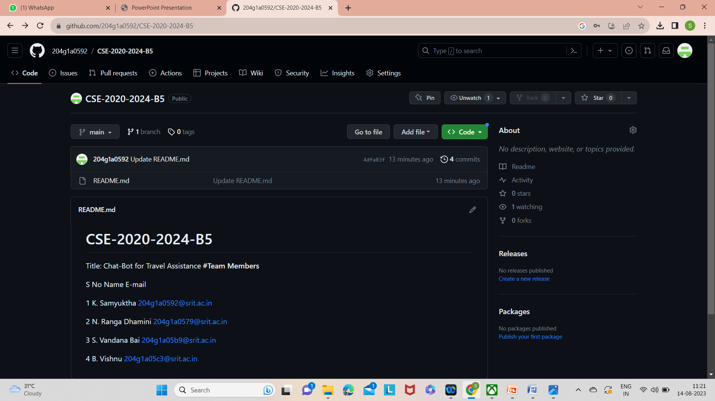
Git Hub Dashboards of each student
https://github.com/204g1a0592/CSE-2020-2024-B5
https://github.com/204g1a0579
https://github.com/204g1a05b9
https://github.com/204g1a05c3

Slide 11
Any Queries?

